Slide 1



Registering for AMP
by Movista

Slide 2
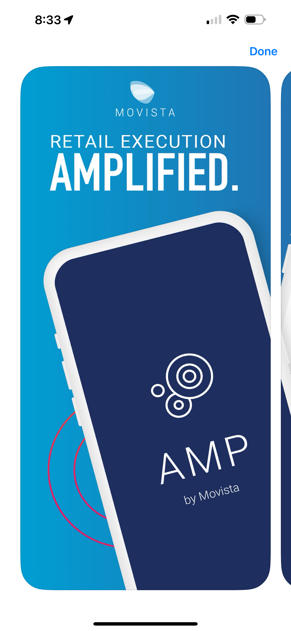
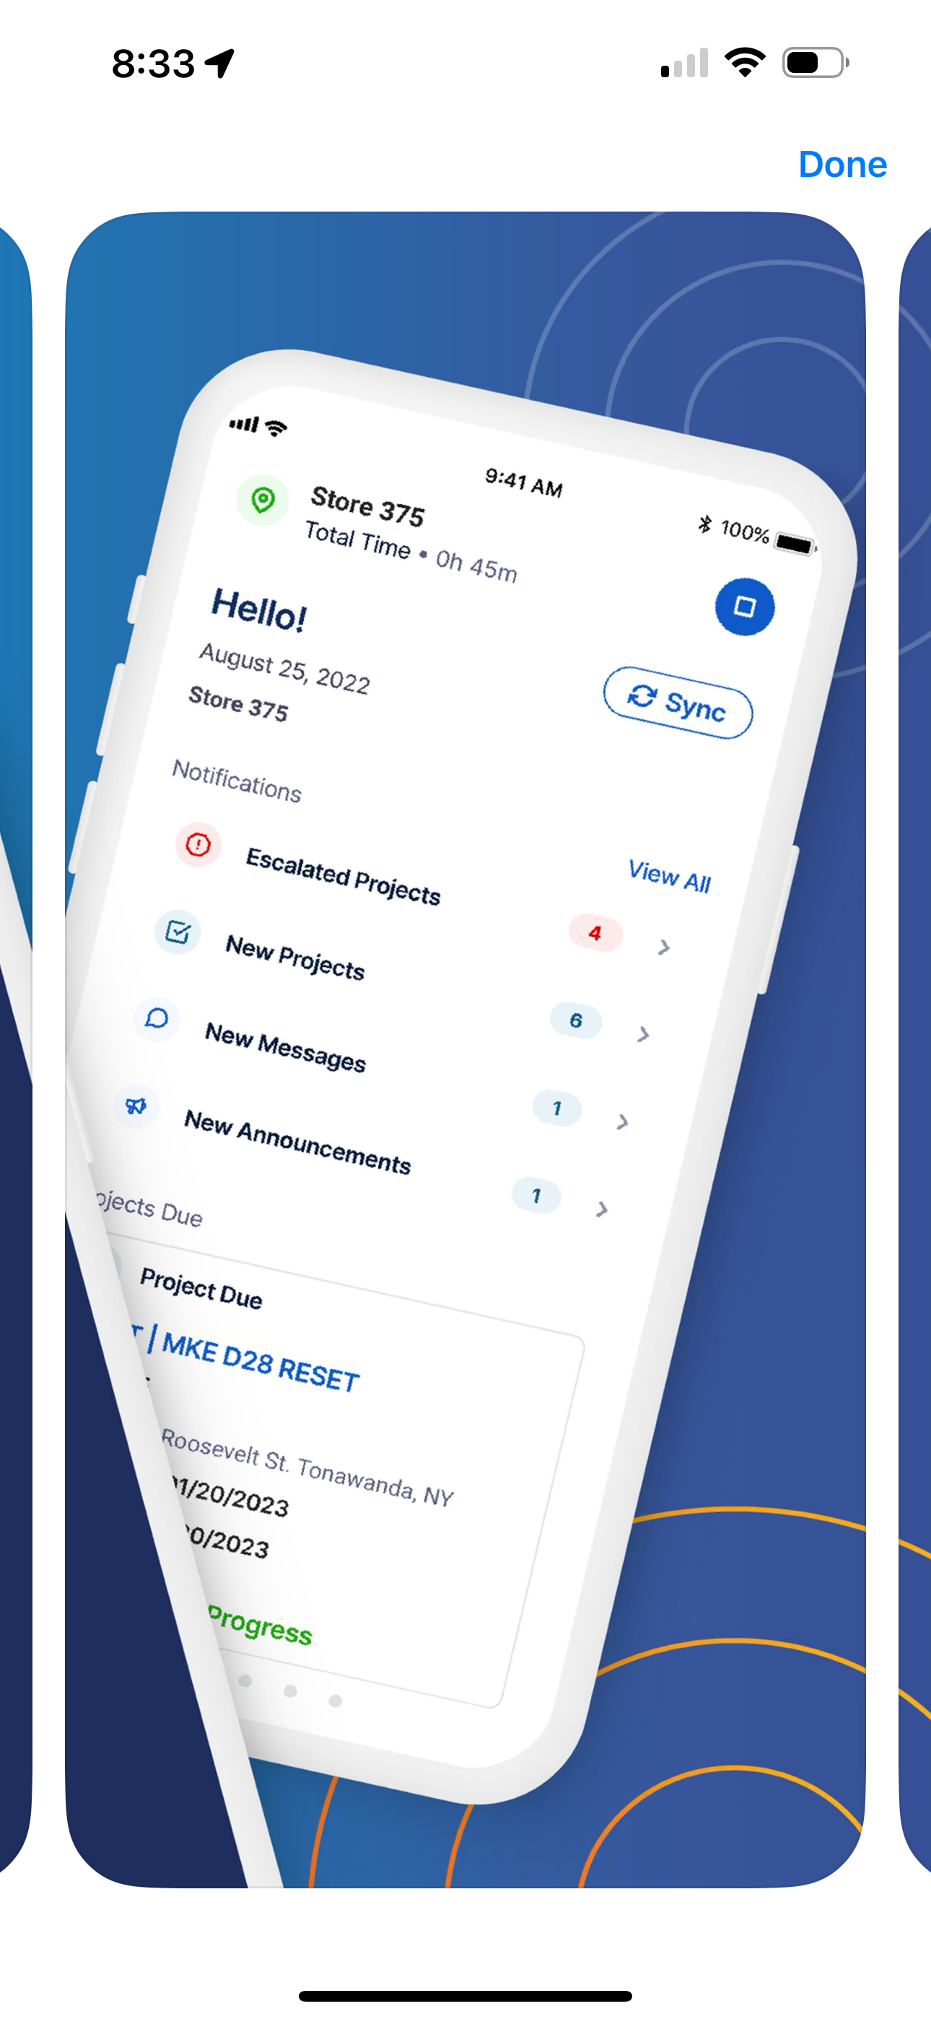
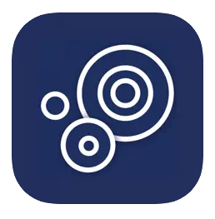


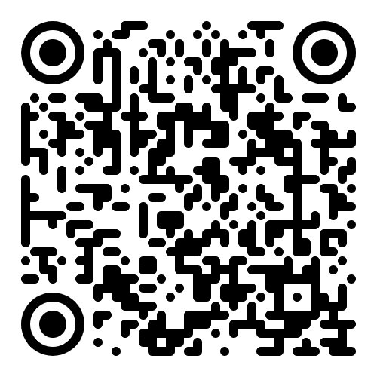
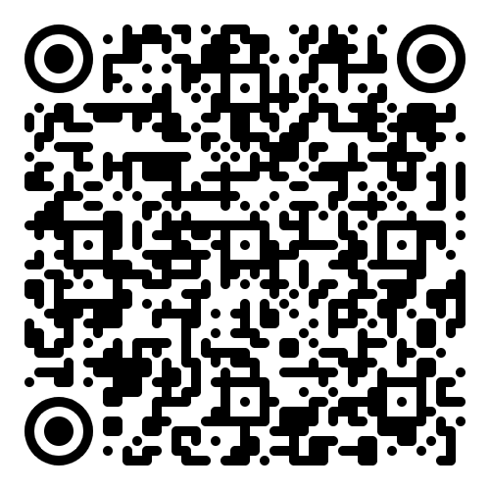
Download App
Amp by Movista
Movista

Slide 3

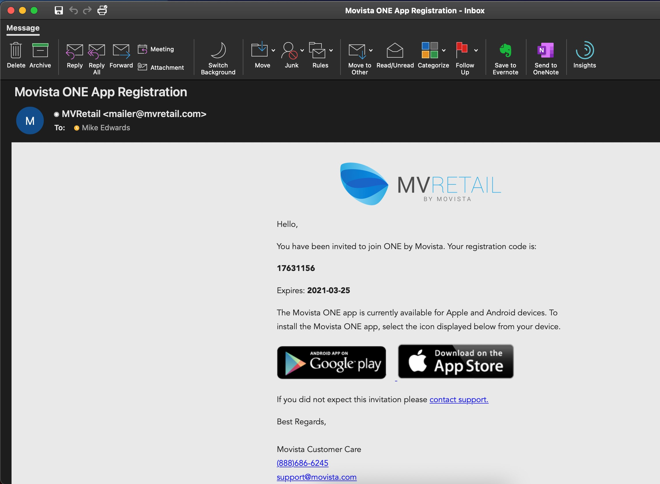

Rep Registration
Registration Email
You will need to register to use the ONE by Movista App
you will receive an email from MVRetail that
looks like this one
It will include a unique registration code that you will use when registering
If you haven't already, you may download the AMP by Movista App in the Google Play store oApple App Store
v

Slide 4
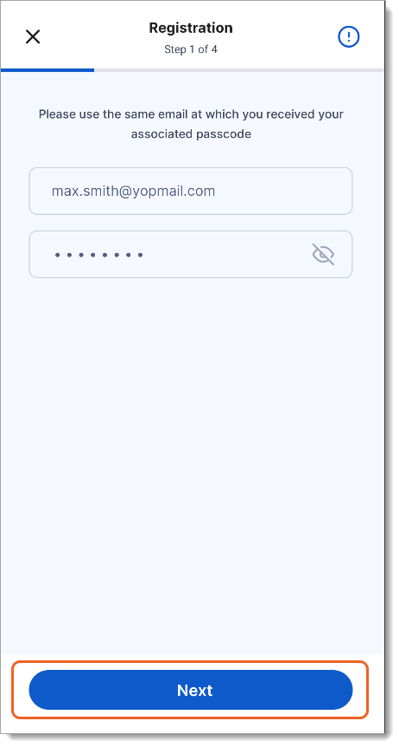
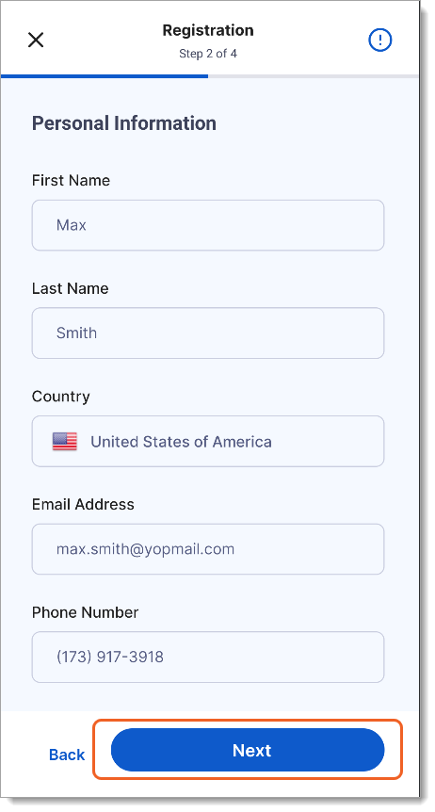
Rep Registration
Registration Process
On the Amp login page, tap Register.
Enter your email address and the passcode that you received by email, then tap Next. Make sure you use the same email address at which you received your passcode.
Enter your personal information. All fields are required:
First Name
Last Name
Country
Email Address
Phone Number
Tap Next.
v

Slide 5
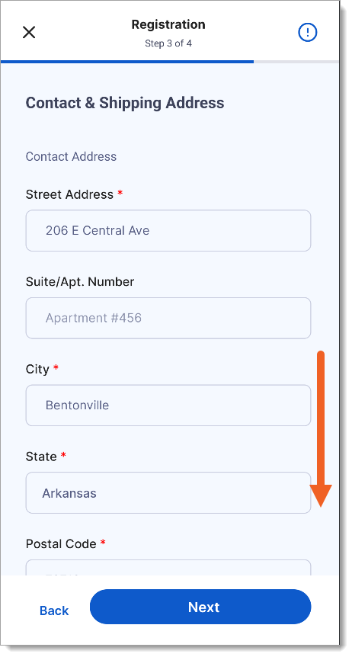
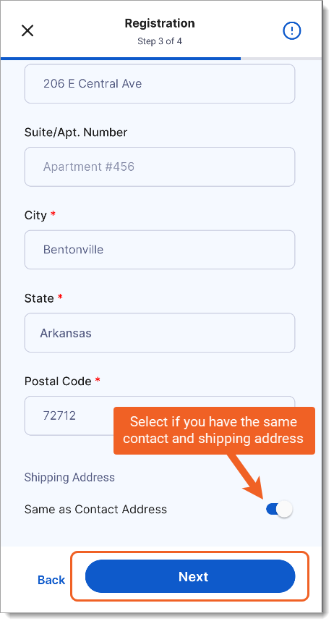
Rep Registration
Registration Process
Enter your contact address. The address fields will vary based on the country that you previously selected.
Enter your shipping address.
If your contact address and your shipping address are the same, tap the option Same as Contact Address to automatically populate the shipping address.
Tap Next.
v

Slide 6
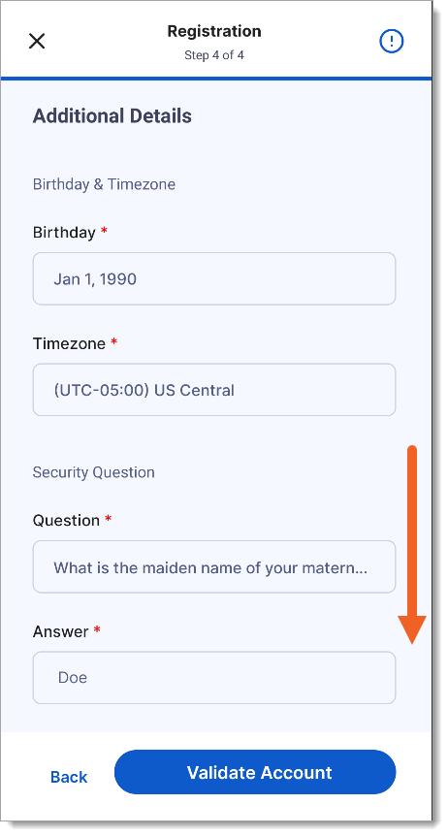
Rep Registration
Registration Process
Enter your additional details:
Birthday: Enter your date of birth.
TIP: To quickly change the year, tap the year in the top left corner of the calendar widget.
Timezone: Select your home time zone.
Security Question and Answer: Select a security question and enter an answer for it. The security question will be used in case you forget your PIN
v

Slide 7
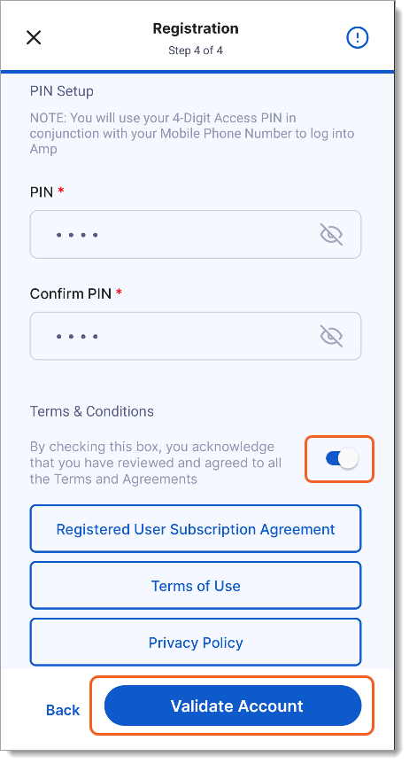

Rep Registration
Registration Process
(Continued) Enter your additional details:
PIN and Confirm PIN: Choose a four-digit PIN. You will use your User ID (typically your phone number) and this PIN to log in to Amp.
Accept the Terms & Conditions by reviewing the associated documents and tapping the toggle button
Tap Validate Account.
Tap Go to Login to return to the login page. You can now log in with your User ID and the PIN that you just created.
v

Slide 8
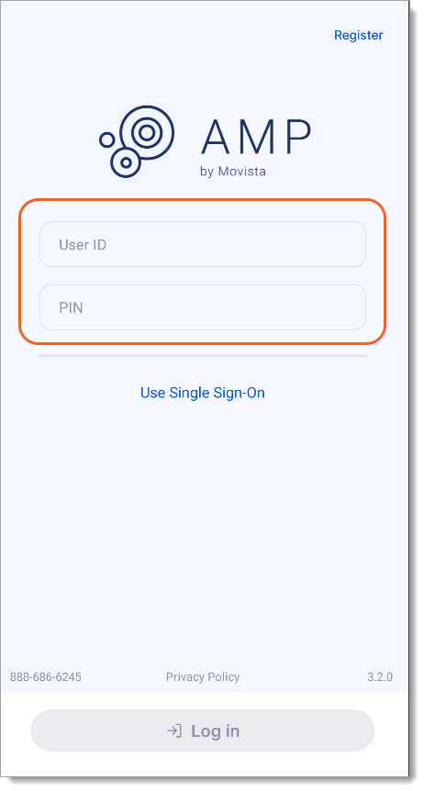
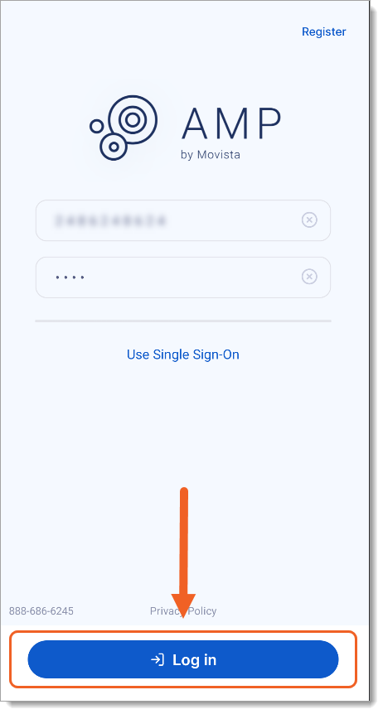
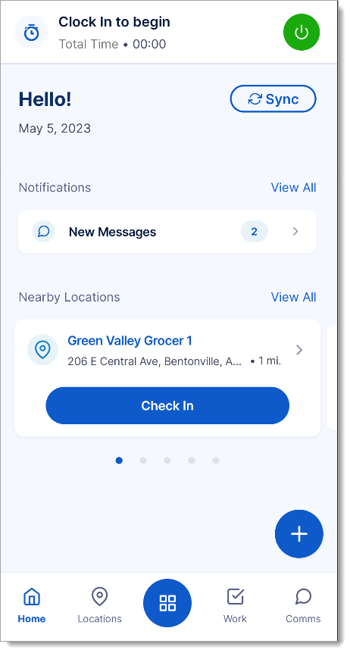
Rep Registration
Logging In
On the Amp login page, enter your User ID (typically your mobile phone number).
Enter your PIN.
Tap Log in.
After you have logged in, you will stay logged in for a set period of time, as configured by your organization. If you close Amp and re-open it you will need to enter your PIN again. After your session has ended, you will need to log in again to continue using Amp.
v

Slide 9
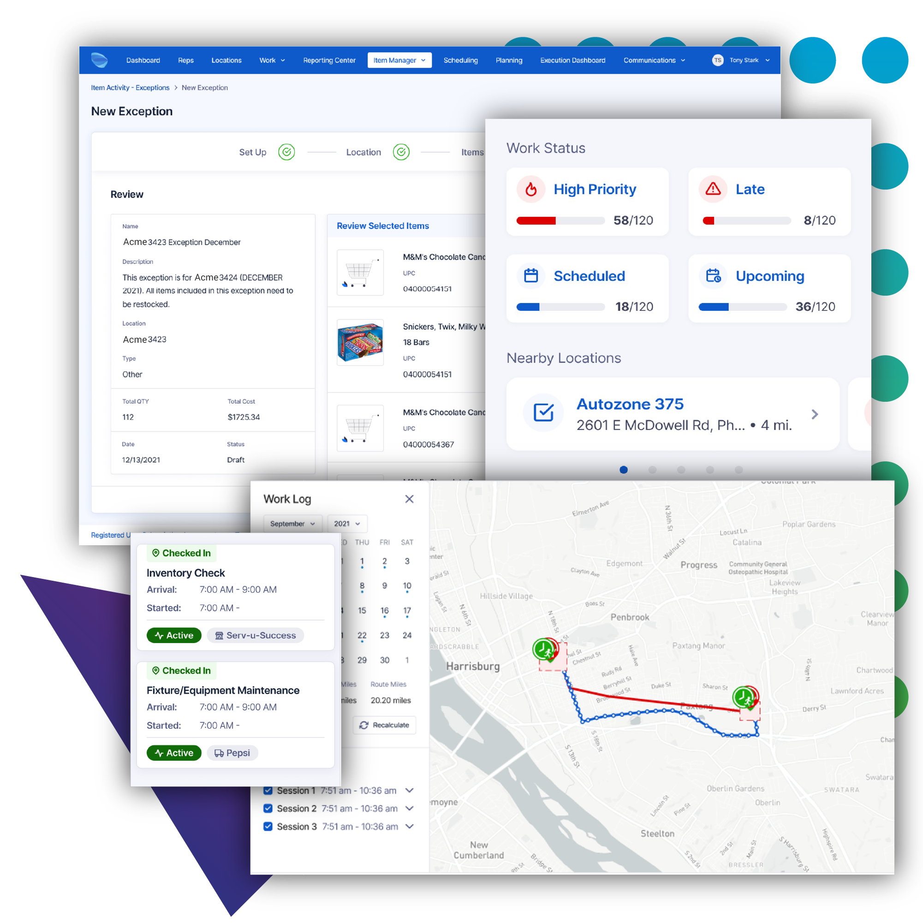








Movista Solution
FIELD TEAM TOOLKIT
Real-time task management
Creates work that directs, instructs, and requests data to be collected, enable alerts when tasks are becoming overdue
Time & Mileage tracking
Accurately confirm and categorize time for each project or task
Insights
Measure and prioritize project execution at scale with real-time insights on completion rates, activity status and more. Go further with actionable dashboards and reports powered by Google Looker
Location Management
Tracking of store-specific location details that enable you to deploy work appropriate for the location
People / Roles management
Align associates to roles, skills, attributes, clients, and locations for higher productivity
Communications & Media
Group messaging, 1:1 chats, announcements and media sharing all within the same app the work is being completed
GPS verification
Ensures that projects are completed at the store, photos are taken at the store
Mobile Reassignments
Mobile reassignment allows a user to reassign incomplete or at-risk work, or pick up a task that has not been completed

Slide 10
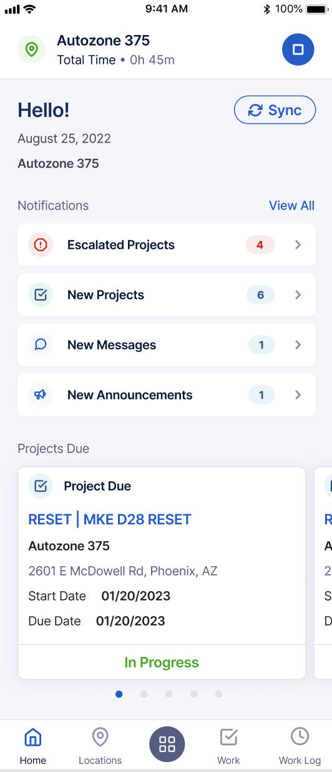
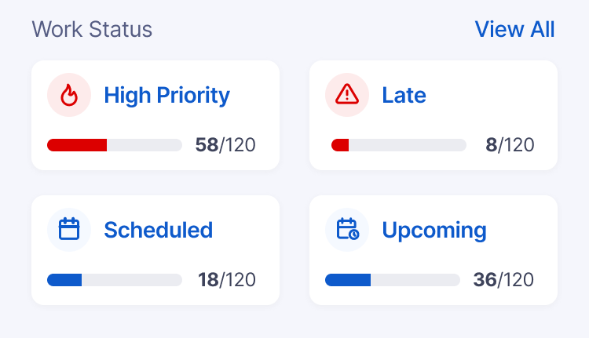
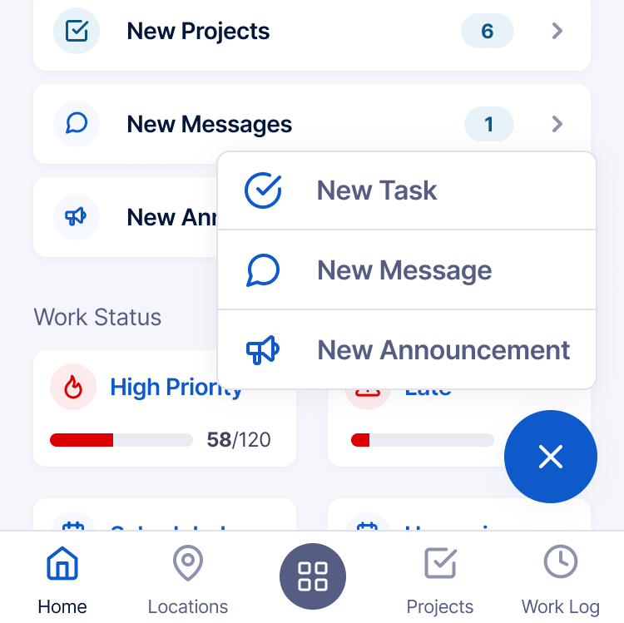

Daily Dashboard
Mobile users start their day with the Daily Dashboard to quickly see quickly see any at-risk work and important messages.
Users can customize their home screen to include the following widgets:
Escalated and newly assigned projects
New Communications
Projects Due at Nearby Locations
Nearby Location for Check in/ out
Scheduled Work Activity
Notes:
Customer Pain Points Overall, this new feature would provide frontline employees with the tools they need to execute their work more efficiently and effectively, while also keeping them informed and engaged with their team and organization.
Competitive Differentiators
Several Brand/ MSO competitors do not have a daily dashboard (Repsly, GoSpotCheck, StayinFront). Position ourselves as a social media-look at feel for easy adoption among frontline employees. Customize the daily dashboard for what is important for your employees, including clock in/ clock out, upcoming work and priority projects.
.
Plus sign is part of store tasking

Slide 11
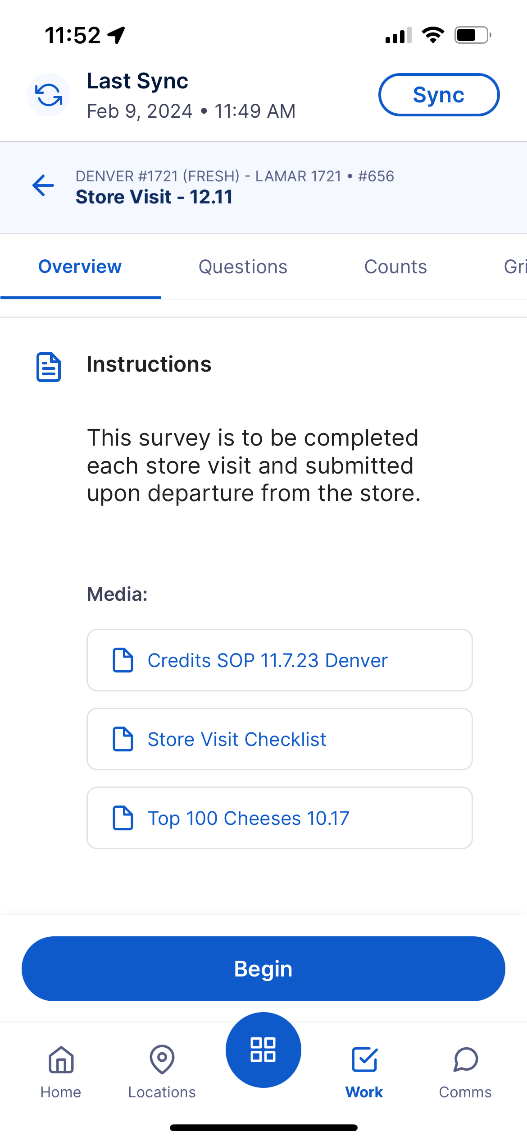
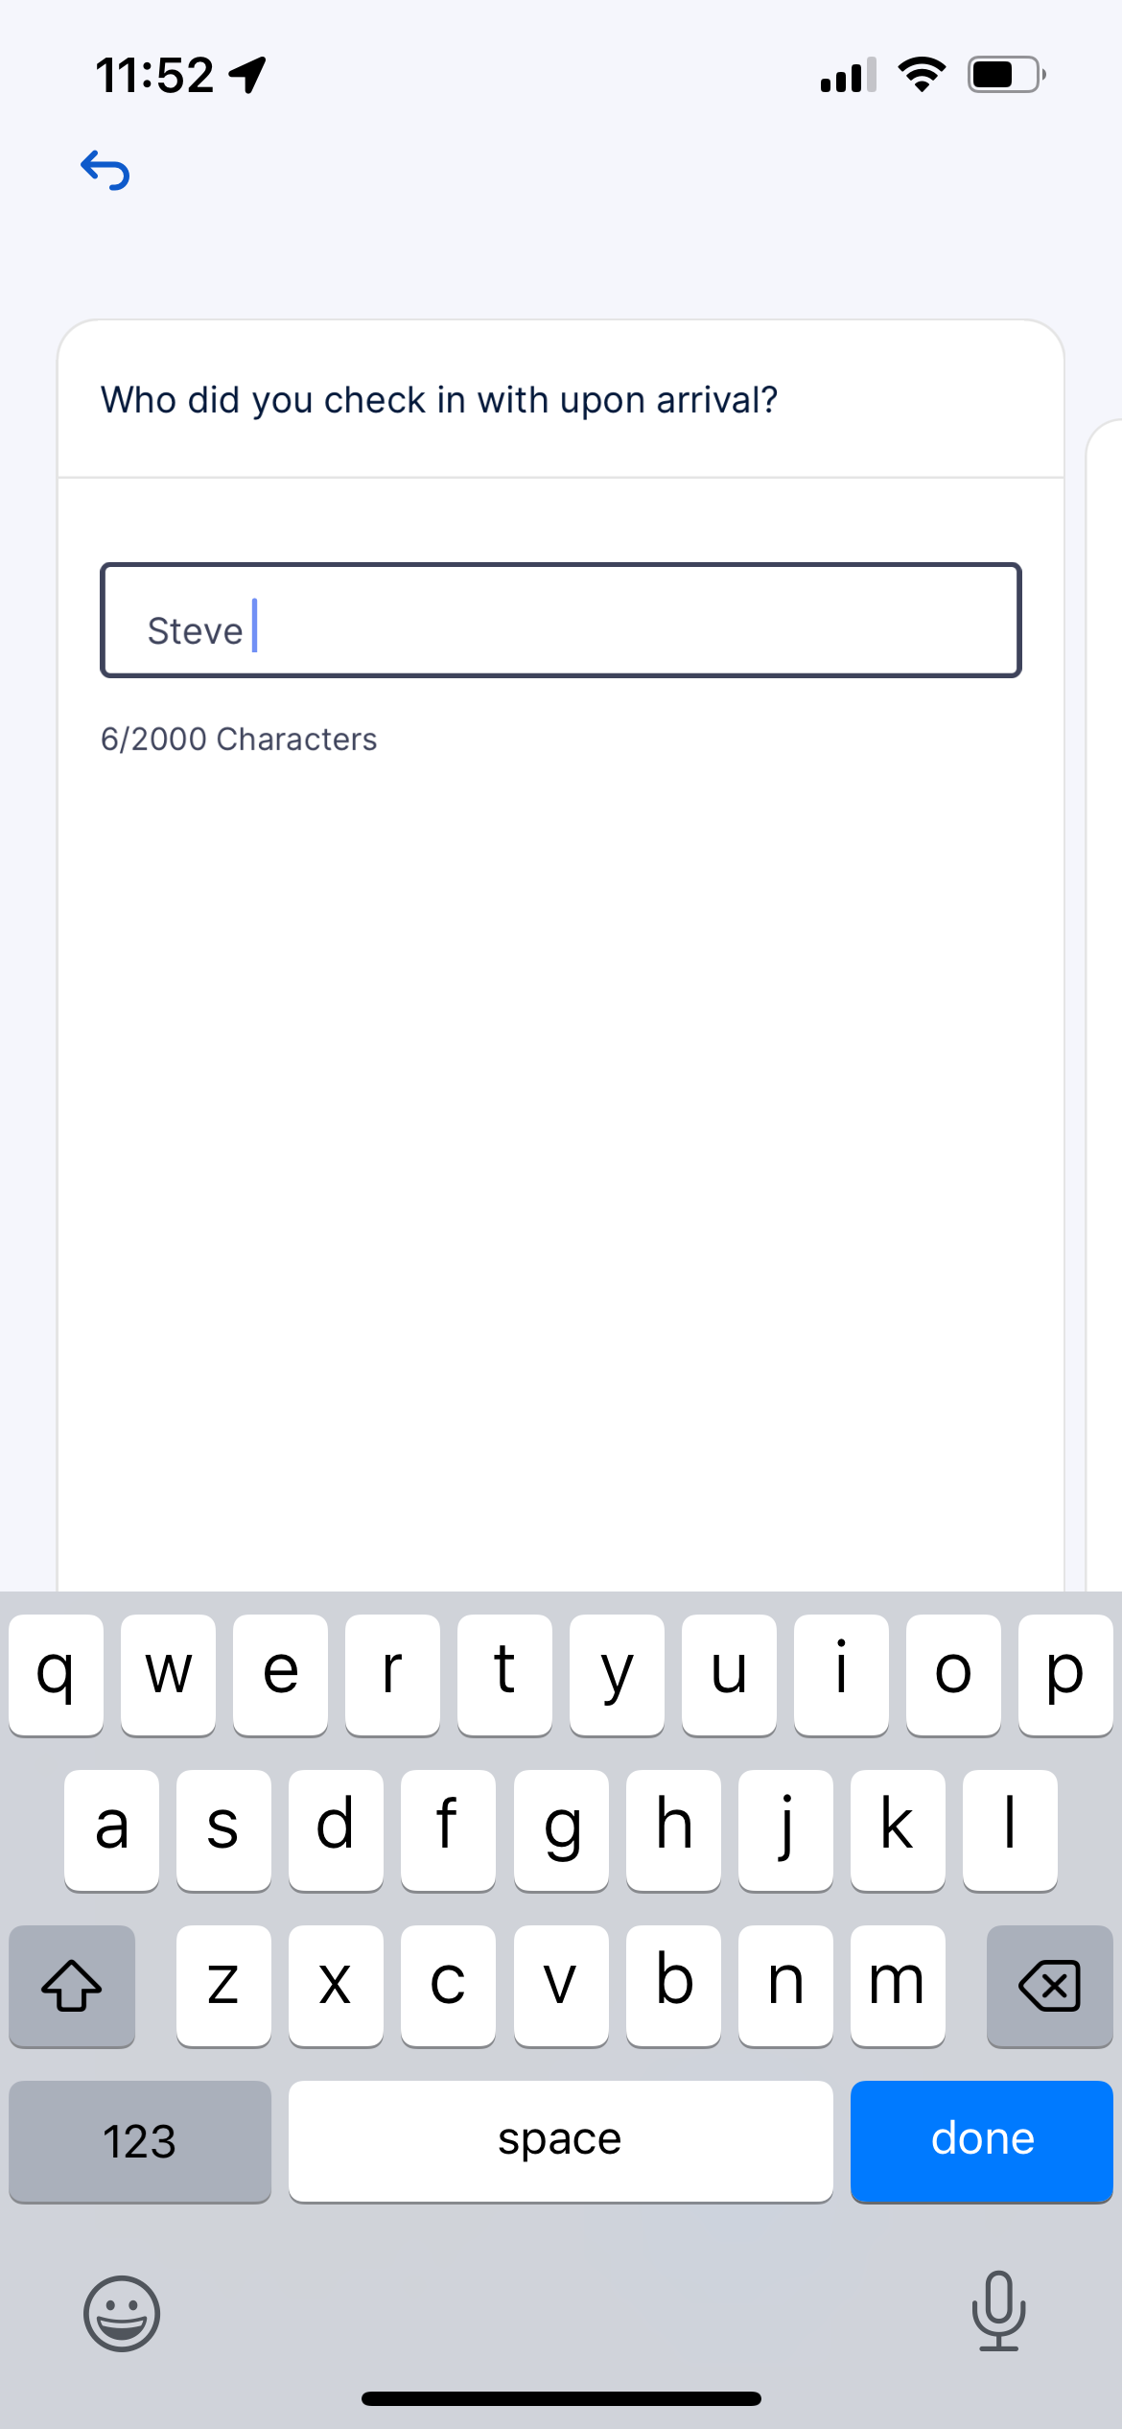
Projects
Mobile users complete assigned projects in the App.
Key features:
Project specific questions
Photo/Signature capture
Item Counts/Grids
Project status
Scheduling
Notes:
Customer Pain Points Overall, this new feature would provide frontline employees with the tools they need to execute their work more efficiently and effectively, while also keeping them informed and engaged with their team and organization.
Competitive Differentiators
Several Brand/ MSO competitors do not have a daily dashboard (Repsly, GoSpotCheck, StayinFront). Position ourselves as a social media-look at feel for easy adoption among frontline employees. Customize the daily dashboard for what is important for your employees, including clock in/ clock out, upcoming work and priority projects.
.
Plus sign is part of store tasking

Slide 12
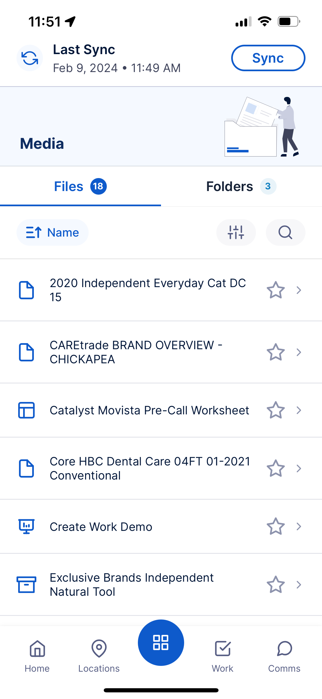
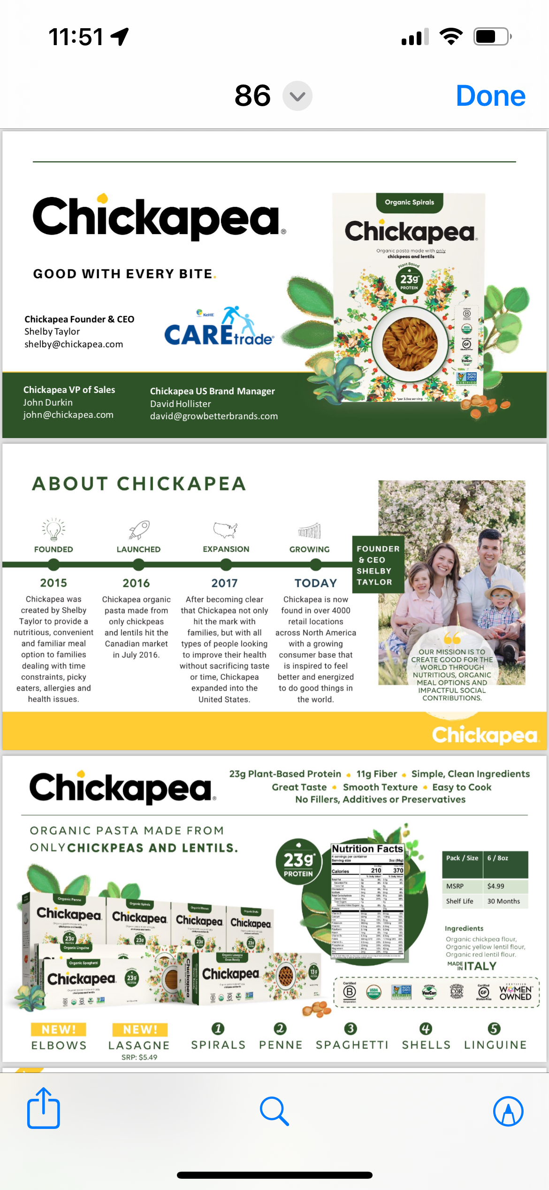
Media
Allows the mobile users to view files that are necessary for their daily tasks.
Supports most file types: .xls, .doc, .pdf, .ppt
Can be viewed at anytime or attached to a project

Slide 13
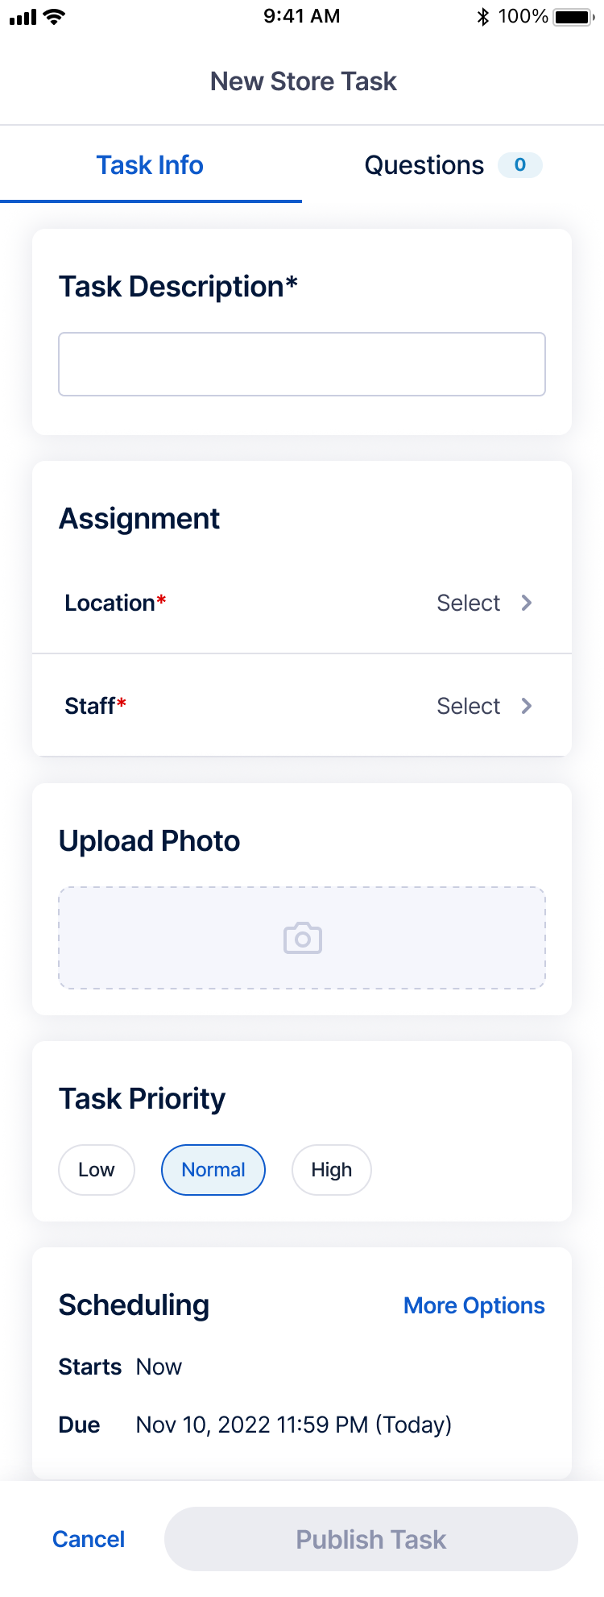
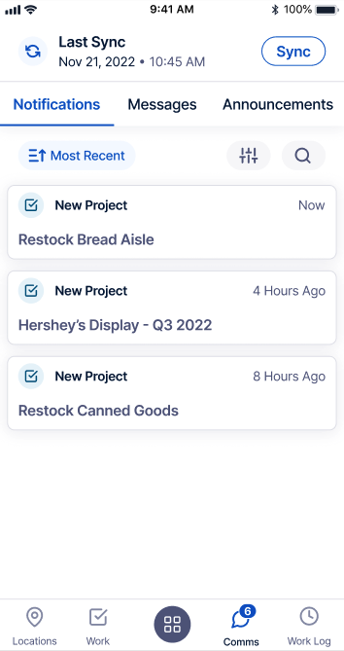
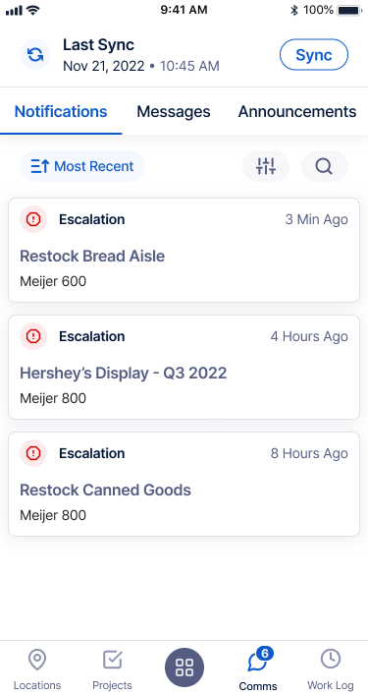
Mobile Tasking
Movista's mobile tasking was built for modern retail on any mobile device all within one intuitive app.
Create tasks on the fly
Assign priority tasks
Delegate department specific tasks
Receive alerts when tasks are becoming overdue

Slide 14
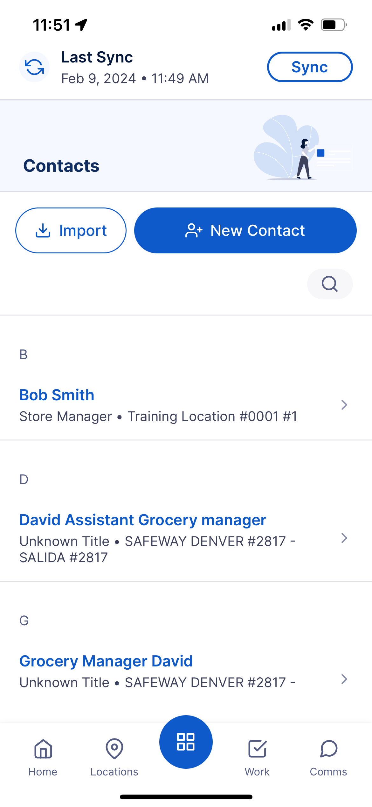
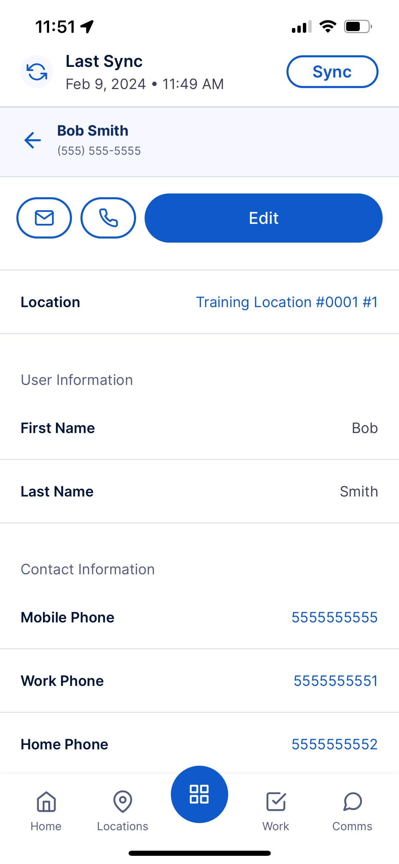
Contacts
Mobile users can add/update key store contact information in the App.
Key features:
Names
Titles
Phone #s
Email
Notes
Notes:
Customer Pain Points Overall, this new feature would provide frontline employees with the tools they need to execute their work more efficiently and effectively, while also keeping them informed and engaged with their team and organization.
Competitive Differentiators
Several Brand/ MSO competitors do not have a daily dashboard (Repsly, GoSpotCheck, StayinFront). Position ourselves as a social media-look at feel for easy adoption among frontline employees. Customize the daily dashboard for what is important for your employees, including clock in/ clock out, upcoming work and priority projects.
.
Plus sign is part of store tasking

Slide 15
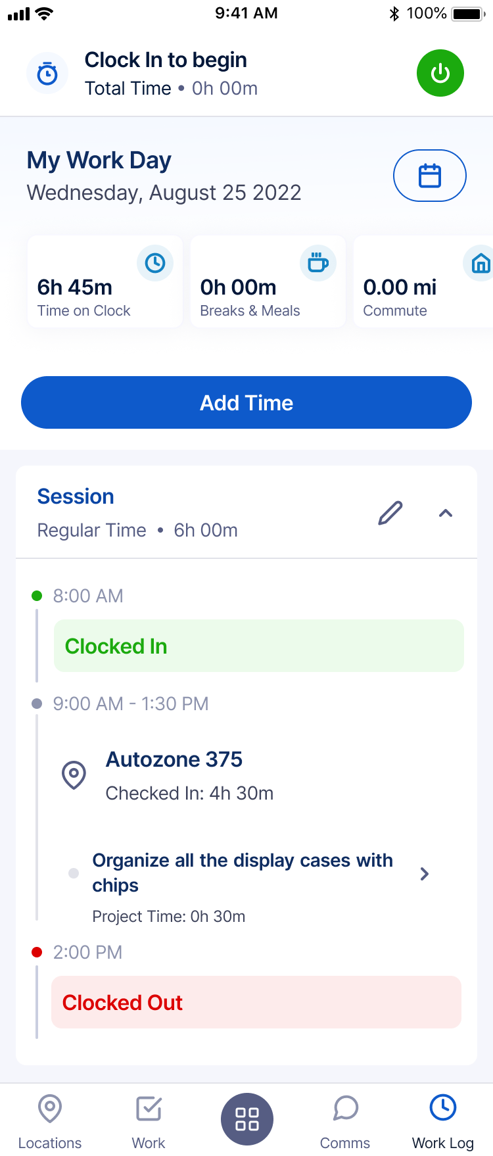
Work Log
Provides an overview within the mobile application of daily activities:
View/Edit time checked into location
View time spent on Projects and Project responses
Notes:
Training Material.

Slide 16
THANK YOU
For questions, please contact
Movista Customer Care Team
(888) 686-6245

